Slide 1

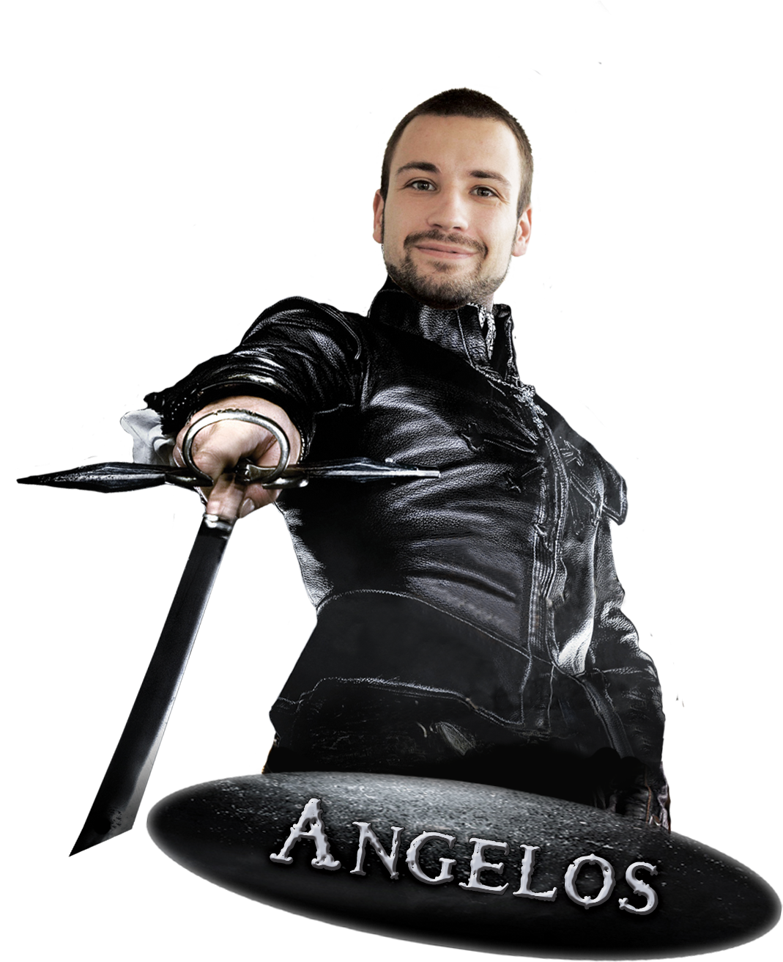
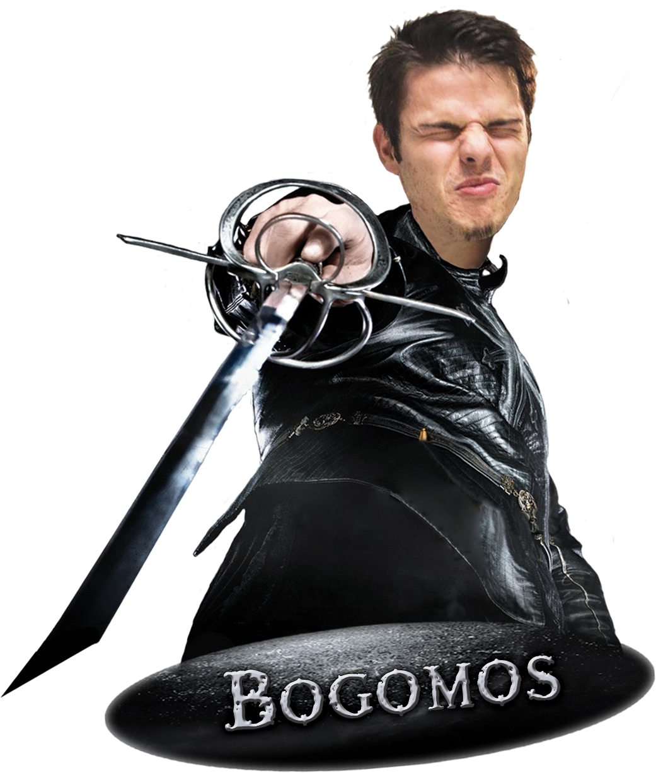
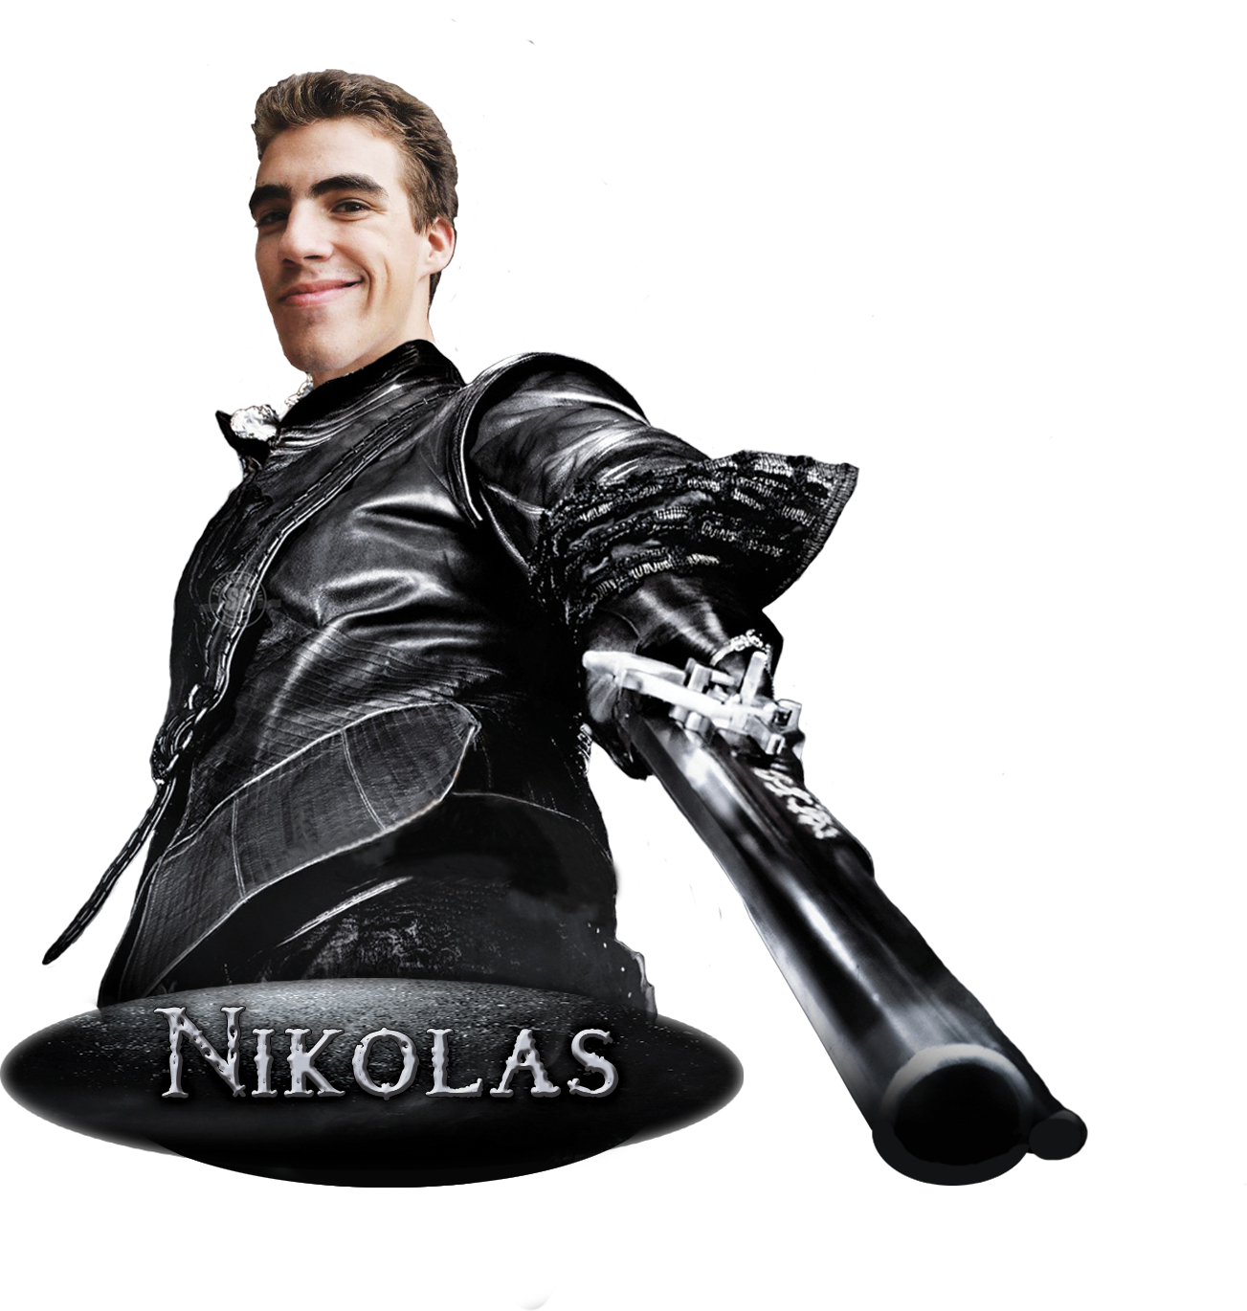
<TEAM/> <EMERALD/>
<vessela.cloudvps.bg/>
<Teamwork Project Assignment for the web Fundamentals (HTML & CSS) Course @ SoftUni/>

Slide 2
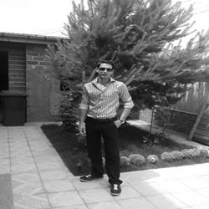

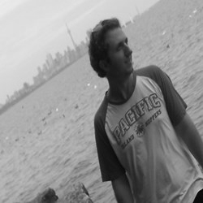
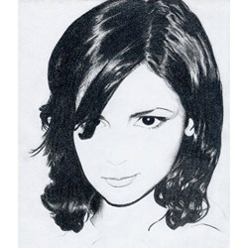
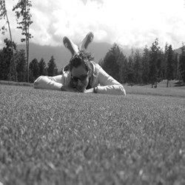
<TEAM EMERALD/>
<Lyuben Kikov/>
<Konstantin Kirchev/>
<Emilia Pavlova/>
<Vesela Toleva/>

Slide 3
<TEAM EMERALD/>
The Three Softwareers – story about three young, intelligent, handsome and brave knights!
Their mission is to teach all the lame candidate programmers to code with all the best practices.
They are fighting against boring life and trying to answer all the stupid questions they have been asked.
… To Be Continued ☺

